Slide 1
Introduction to Light Year 9 Physics

Slide 2
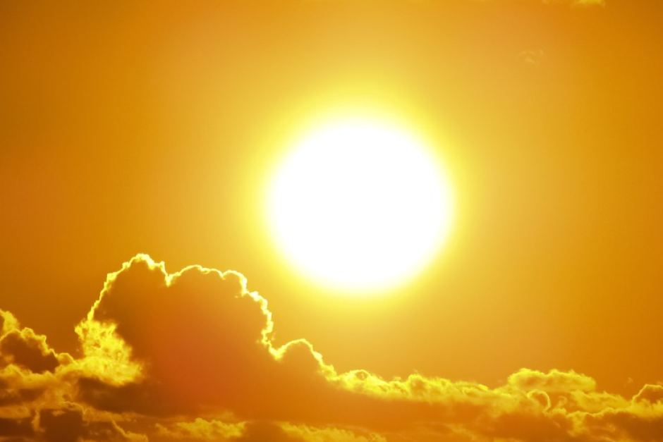
Learning Objectives
CFU
What are we going to learn?
Identify luminous and non-luminous objects.
Describe the difference between transparent, translucent and opaque objects.
Activate Prior Knowledge
Light energy is a form of kinetic energy that enables us to see.
On your whiteboard, list three other objects that produce light energy.

Slide 3
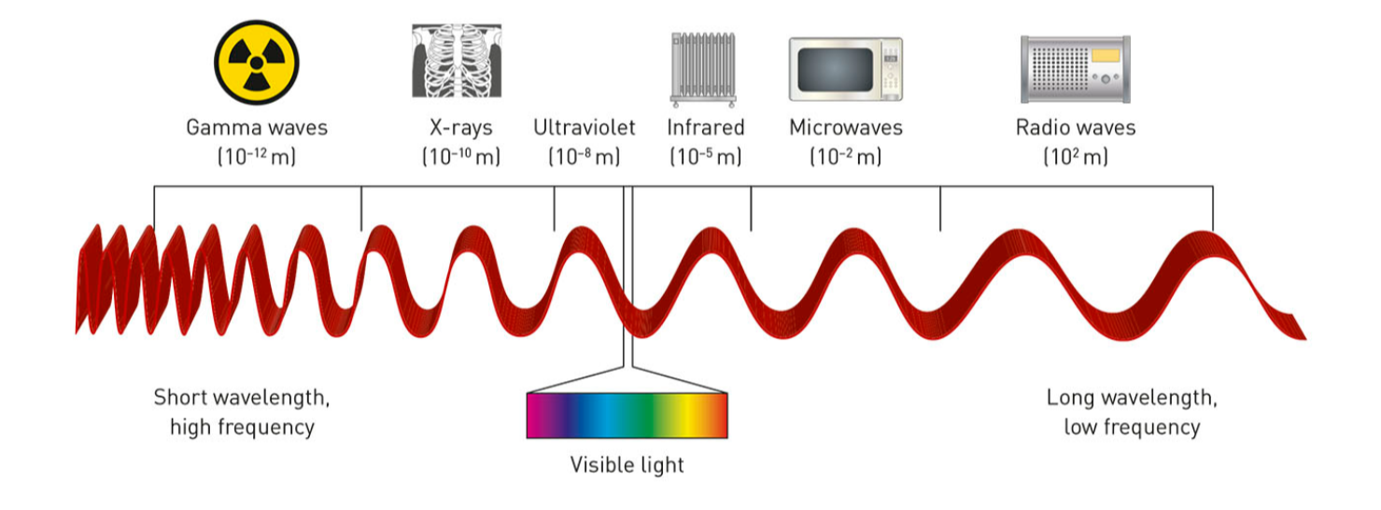
Concept Development
CFU 1
What is the name given to the range of energy emitted by objects?
The Electromagnetic Spectrum
The visible light we see is one part of a range (or spectrum) of energy emitted from objects.
This spectrum is called the electromagnetic spectrum.
It ranges from low energy waves, like radio waves, to high energy waves, like gamma waves.
CFU 2
Other than radio waves, name a low energy wave.
CFU 3
Are x-rays a high energy or a low energy wave?

Slide 4

Concept Development
CFU 1
How do the oscillations move in a transverse wave?
The Electromagnetic Spectrum
The waves that form the electromagnetic spectrum are a type of transverse wave.
In transverse waves, the oscillations are perpendicular (at right angles) to the direction of wave travel.
Ripples in a pond are another form of transverse wave.
CFU 2
How is a transverse wave different to a longitudinal wave?
CFU 3
Name an example of a transverse wave and a longitudinal wave.
Direction of oscillation
Direction of wave movement
Direction of wave movement
Direction of oscillation

Slide 5
Concept Development
CFU 1
What is the difference between luminous and non-luminous objects?
Luminous and Non-luminous Objects
Luminous objects are objects which emit (or produce) light.
Examples of luminous objects include the Sun, lightbulbs, torches and flames.
Non-luminous objects are objects which cannot produce their own light, but reflect light or allow light to pass through the object.
Examples of non-luminous objects include the Moon, your desk, a window and an apple.
CFU 2
On your whiteboard, list two more luminous objects and two non-luminous objects.

Slide 6
Concept Development
CFU 1
What are the three types of non-luminous objects?
Interaction of Light with Non-Luminous Objects
Non-luminous objects can only be seen because light from a luminous object reflects off it and enters our eye.
There are three types of non-luminous objects, which interact with light in different ways:
Transparent
Translucent
Opaque
CFU 2
Why are we able to see non-luminous objects even though they don’t produce light?

Slide 7
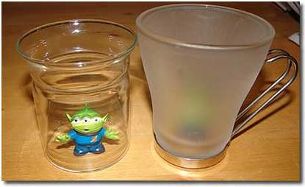
Concept Development
CFU 1
How are opaque objects different to transparent and translucent ones?
Interaction of Light with Non-Luminous Materials
Transparent materials allow almost all light to pass through. An object can be seen clearly through the material.
Some examples are clear glass and still, shallow water
Translucent materials allow some light to pass through, but light is scattered. Objects seen through the material are blurry.
Some examples are tissue paper and frosted glass.
Opaque materials do not allow light to pass through. The light is absorbed or reflected. Objects cannot be seen through the material.
Some examples are a brick and wood.
CFU 2
Why are we able to see a clear image through a transparent material?
CFU 3
Which object(s) in the image are: Opaque Transparent Translucent

Slide 8
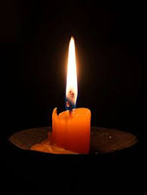
Skill Development/Guided Practice
Describing Light Related Properties of Objects
Does the object produce light? yes = luminous no = non-luminous If no, how much light can pass through the object? none, it is reflected = opaque some, blurry image = translucent all, clear image = transparent
Describe the light related properties of a candle.
A candle produces light, so it is a luminous object.

Slide 9
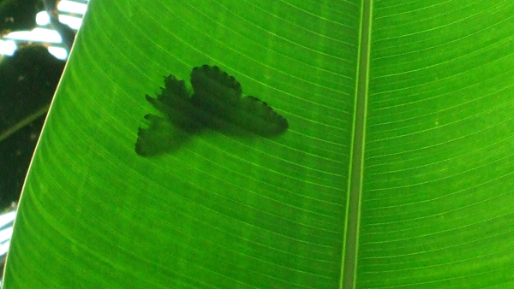
Skill Development/Guided Practice
Describe the light related properties of a leaf.
Describing Light Related Properties of Objects
Does the object produce light? yes = luminous no = non-luminous If no, how much light can pass through the object? none, it is reflected = opaque some, blurry image = translucent all, clear image = transparent
The leaf is a non-luminous object. It is translucent because it allows some light to pass through.

Slide 10
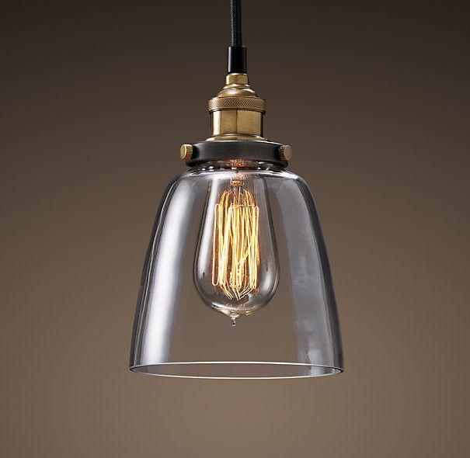
Skill Development/Guided Practice
Describing Light Related Properties of Objects
Does the object produce light? yes = luminous no = non-luminous If no, how much light can pass through the object? none, it is reflected = opaque some, blurry image = translucent all, clear image = transparent
Describe the light related properties of a light bulb.
The lightbulb is a luminous object. It produces light.

Slide 11
Skill Development/Guided Practice
Describing Light Related Properties of Objects
Does the object produce light? yes = luminous no = non-luminous If no, how much light can pass through the object? none, it is reflected = opaque some, blurry image = translucent all, clear image = transparent
Describe the light related properties of the lampshade.
The lampshade is a non-luminous object. It is transparent because light can pass through and the object is clearly seen.

Slide 12
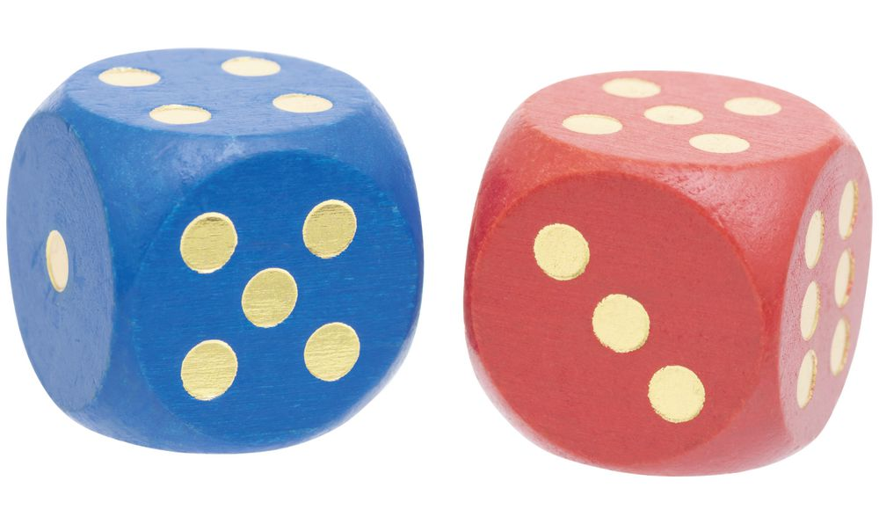
Skill Development/Guided Practice
Describing Light Related Properties of Objects
Does the object produce light? yes = luminous no = non-luminous If no, how much light can pass through the object? none, it is reflected = opaque some, blurry image = translucent all, clear image = transparent
Describe the light related properties of the dice.
The dice are non-luminous objects. It is opaque because light cannot pass through and is reflected.

Slide 13
Relevance
Luminous objects produce light, which can pass through or be reflected by other objects. When this light enters our eyes, it allow us to see the things around us.
Knowing how light interacts with different types of objects will help you understand light phenomena including reflection in mirrors and refraction through different substances.

Slide 14
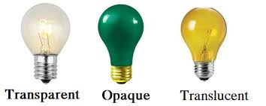
Skill Closure
Explain the difference between the terms luminous and non-luminous. Give an example of each.
Skill Closure
For each of the three types of non-luminous materials, describe what happens to light passing through the material.
Transparent
Opaque
Translucent
Describing Light Related Properties of Objects
Does the object produce light? yes = luminous no = non-luminous If no, how much light can pass through the object? none, it is reflected = opaque some, blurry image = translucent all, clear image = transparent
Skill Closure
Describe the light related properties of a window.

Slide 15
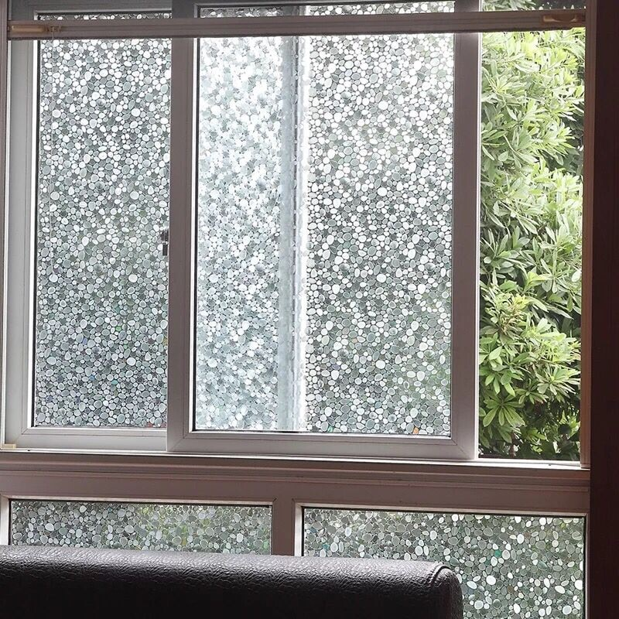
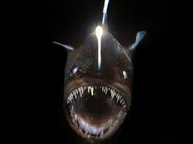
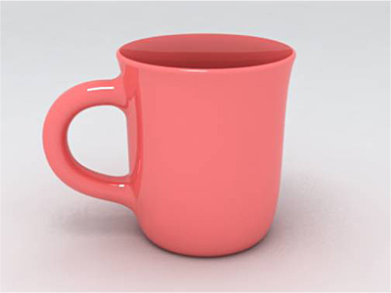
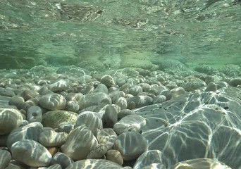
Independent Practice
Answer the following questions in your book or on your device.
Explain the difference between luminous and non-luminous objects. Give 3 examples of each type of object.
Name one place in your home where a transparent object is used, and explain why it is used.
Name one place in your home where a translucent object is used, and explain why it is used.
What happens to light as it falls on an opaque object?
Describe the light related property of each object below. Justify your choice.

